Slide 1



Dewey Beach Delaware
IQ Town Council Presentation

Slide 2
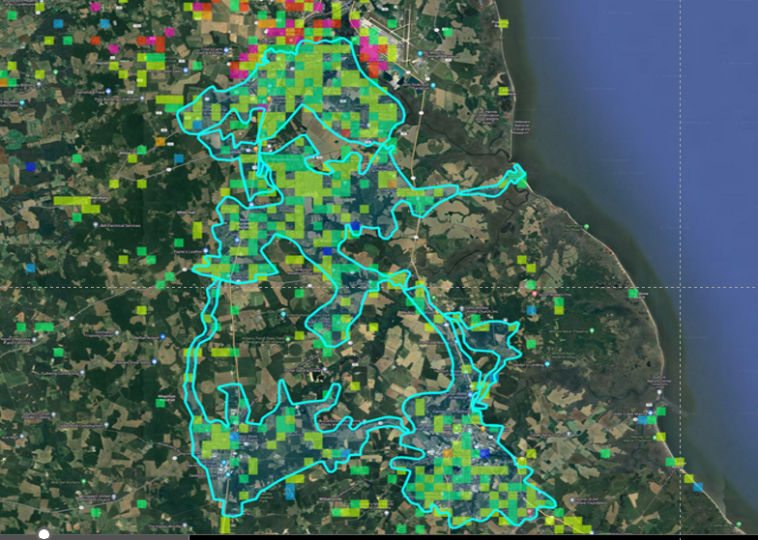
Delaware Upload Speeds show a connectivity problem
Highlighted Ookla Speed Tests Show:
Red = Fiber Fast
Green = Cable Slow

Slide 3
IQ Fiber = Internet at the Speed of Light - Literally
Synchronous speeds are vital for work from home solutions, tele-health appoints and monitoring, and for always on Internet enabled smart devices throughout the home.
Upstream data usage grew 18% last year%
AI Chat functionality alone is expected to increase data usage up to 10x over the next five years. Only a true fiber optic broadband connection can handle these bandwidth needs!
100 Million homes now connected to fiber and this connection can add up to 3.1% to the value of your home

Slide 4
The IQ Fiber Broadband Project Works for Delaware
“The next wave of growth in Delaware is coming from innovation.” This underscores the goal of building an ecosystem where technology startups and high-growth ventures can thrive. Governor Meyer
Sussex County population growth is 6th fastest among all 50 U.S. states = 125 people a day!
Yet Delaware is in the bottom third of the country for new business creation
Governor Meyer’s Executive Order 18 = Coordinated fast track permitting system for priority projects including broadband.

Slide 5
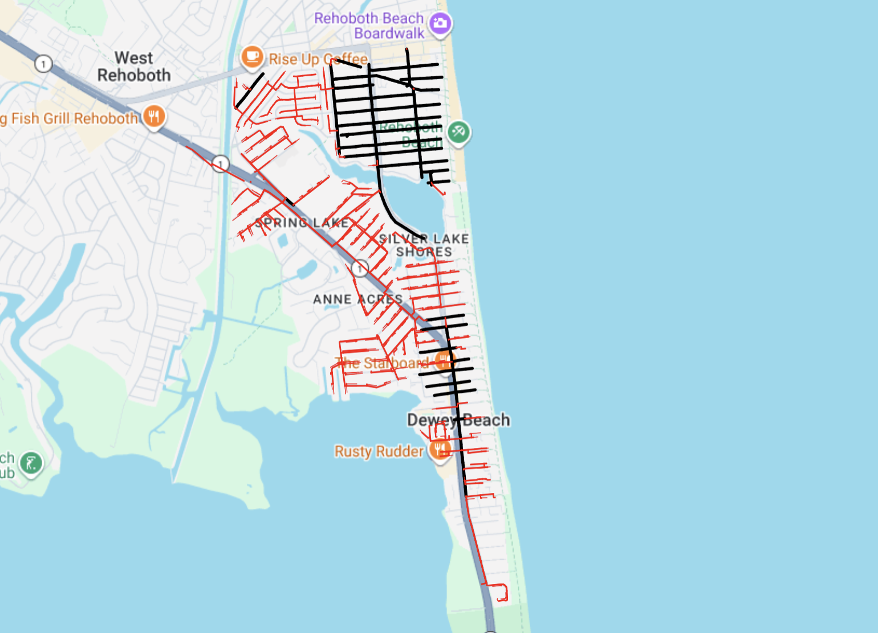
Dewey Beach Build Plan
Build in phases based on one active HUB cabinet and several passive cabinets
Red = Underground
Black = Aerial

Slide 6
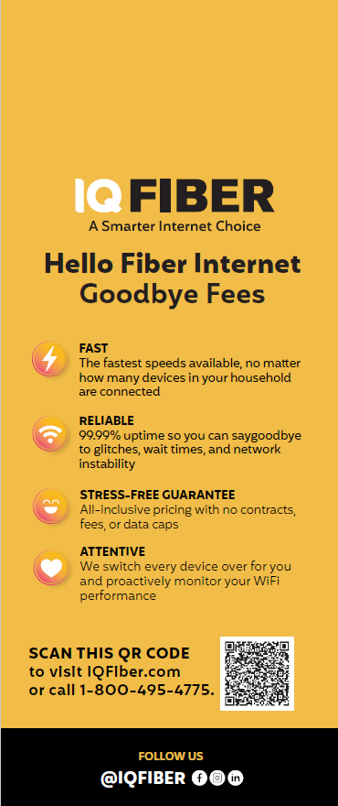
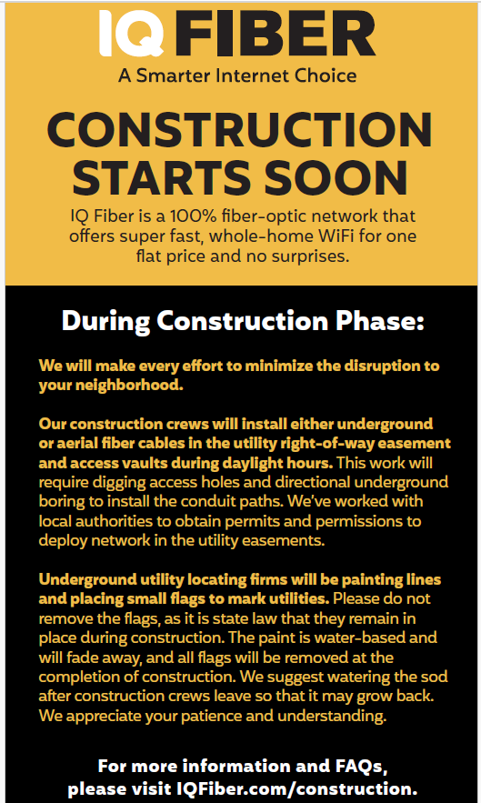
NOTIFICATION OF PRE-CONSTRUCTION
Engage with the Community
Pre-Construction Door Hangers
IQ Fiber team in the Neighborhood
Construction is the first impression – we make it a great one!

Slide 7

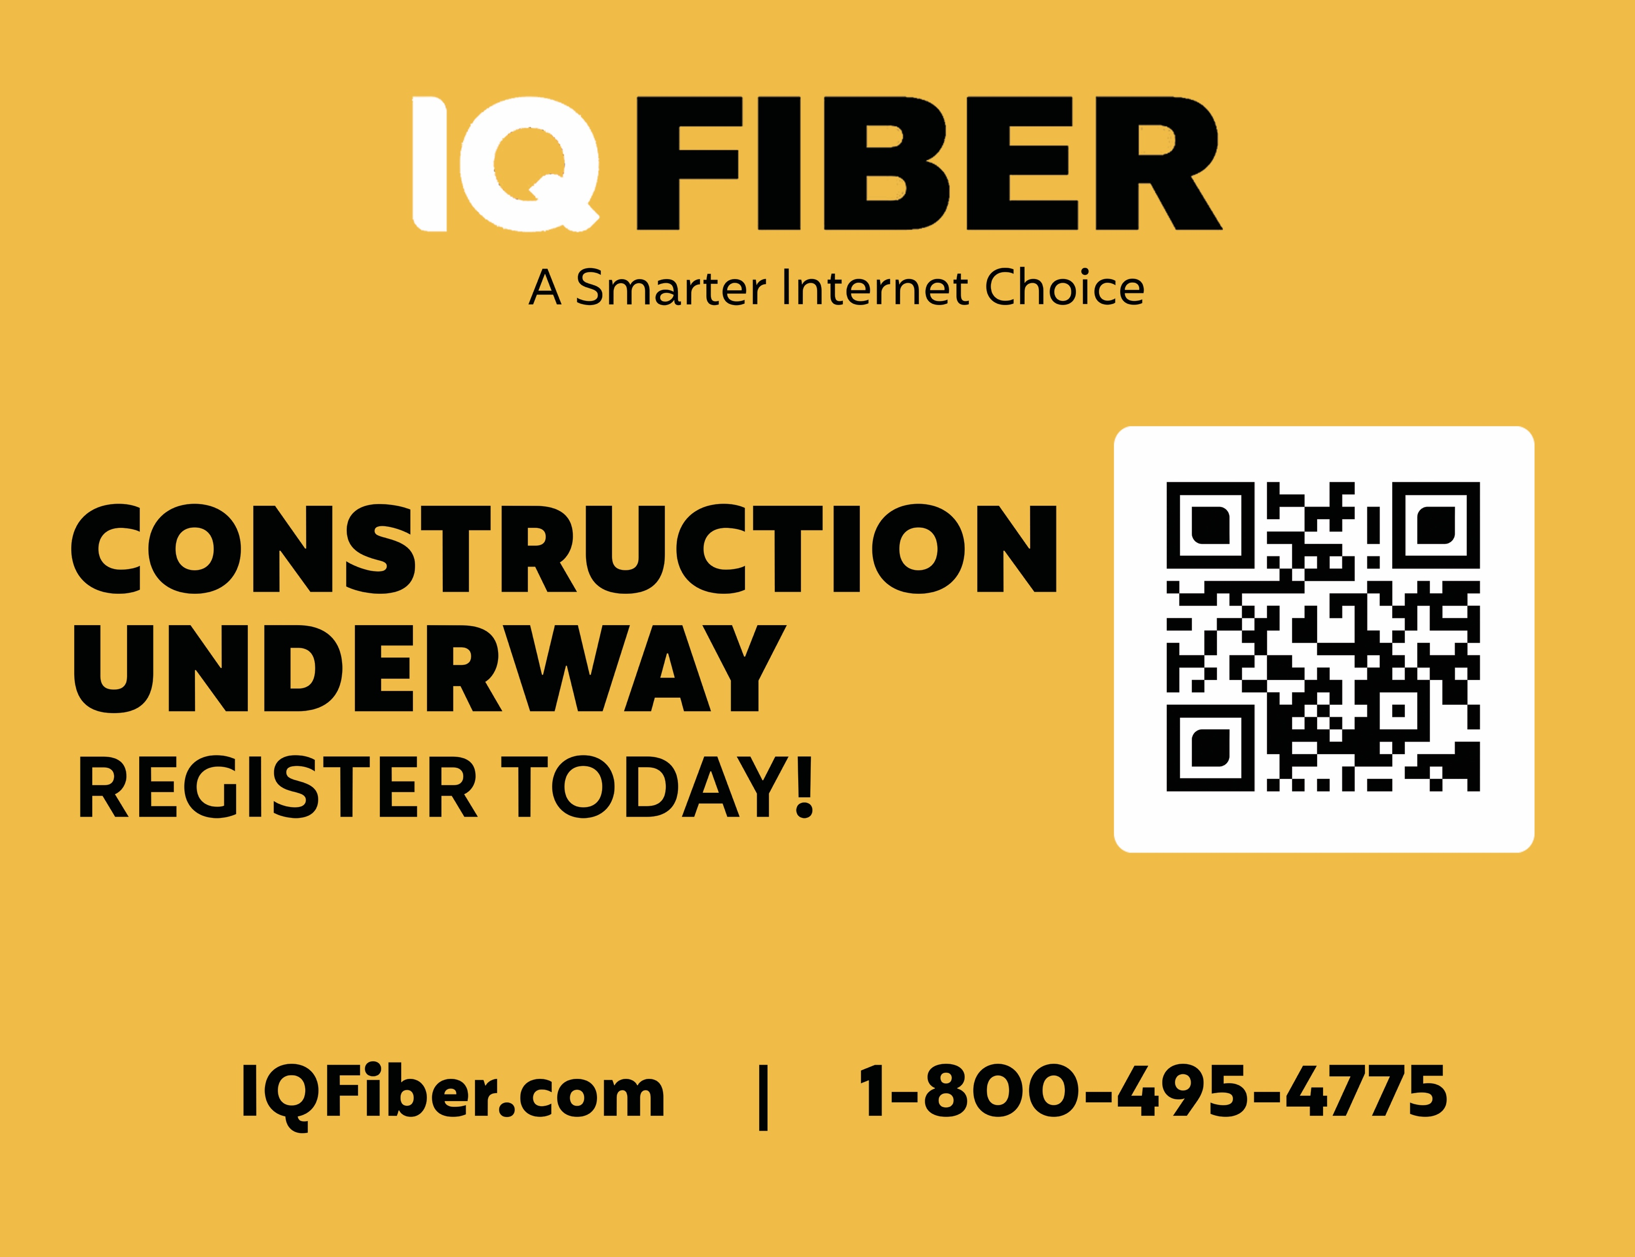

During Construction
The construction process includes the installation of aerial fiber cables or underground conduit and access vaults in the public right-of-way adjacent to the road. We will place a notice on your door when construction is about to begin. Throughout the process we will provide updates via social media, email, construction signs, and on our website.
Once the underground conduit and access vaults are in place, our construction teams will install the fiber-optic cables and connect them together to create one seamless network. The network is then tested to ensure that it is up to our quality standards for speed and reliability.
IQ FIBER PROPRIETARY AND CONFIDENTIAL

Slide 8
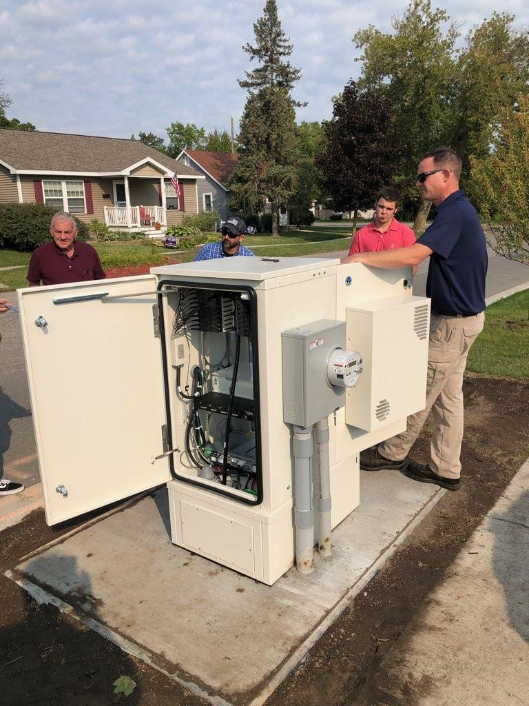
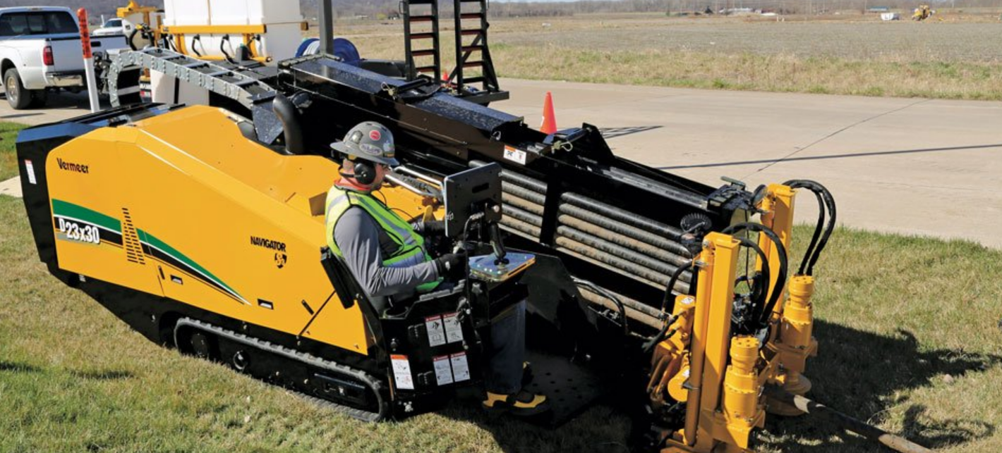
IQ Fiber Optic Construction Methods

Slide 9
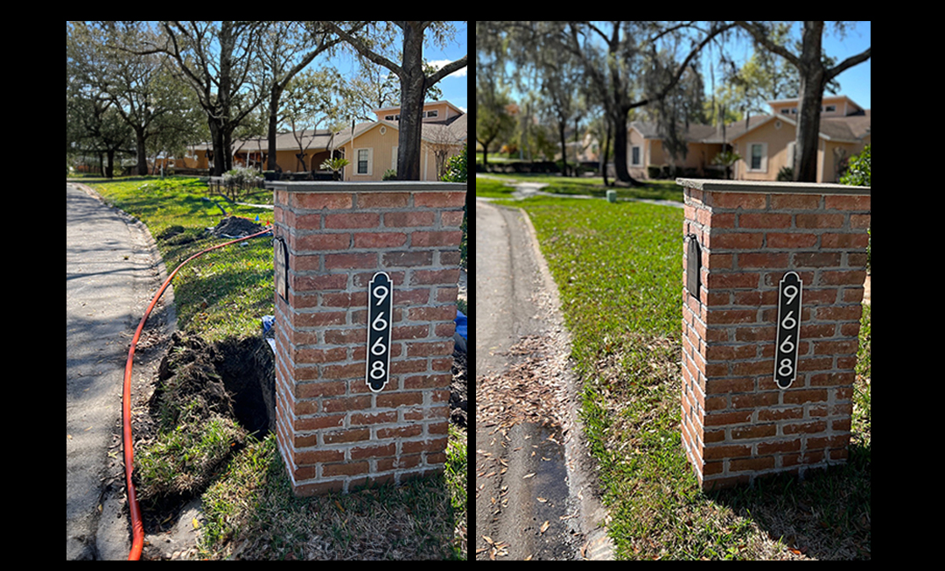
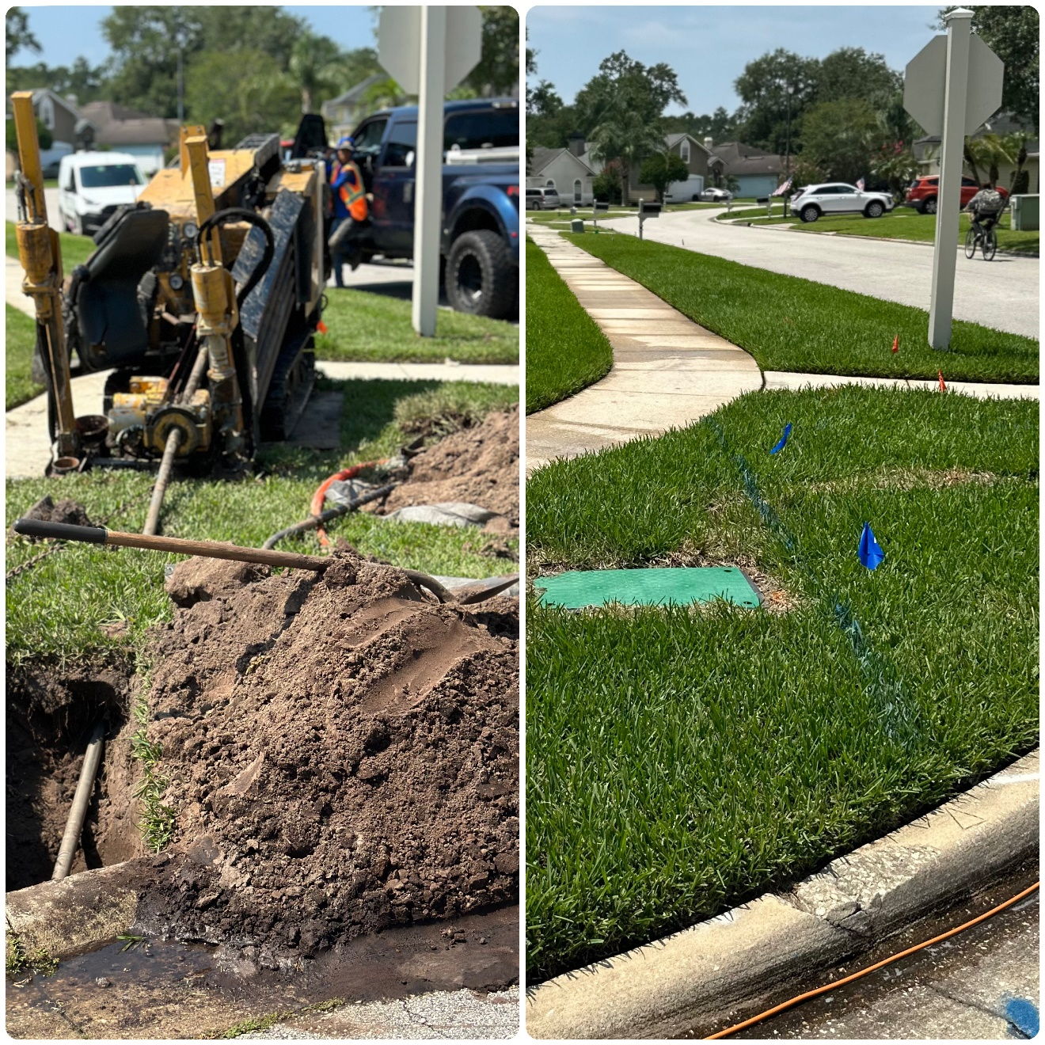
Construction & Restoration Process
BEFORE
AFTER
BEFORE
AFTER

Slide 10
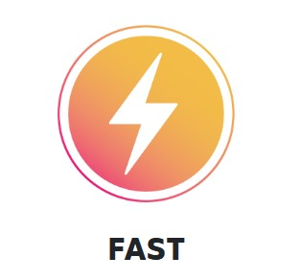
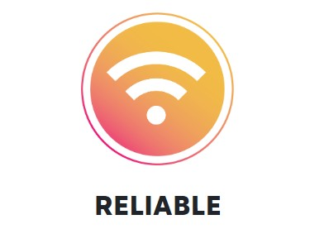


The IQ Fiber Way
100% Fiber-Optic Internet
Fastest Speeds Possible0%
Wall -to -wall coverage no wait times or lag and 99.9% uptime!
Stress Free Guarantee
No Contract
No Fees
No Data Caps
Free Wi-Fi Equipment
In -house call center
Proactively monitoring your service

Slide 11
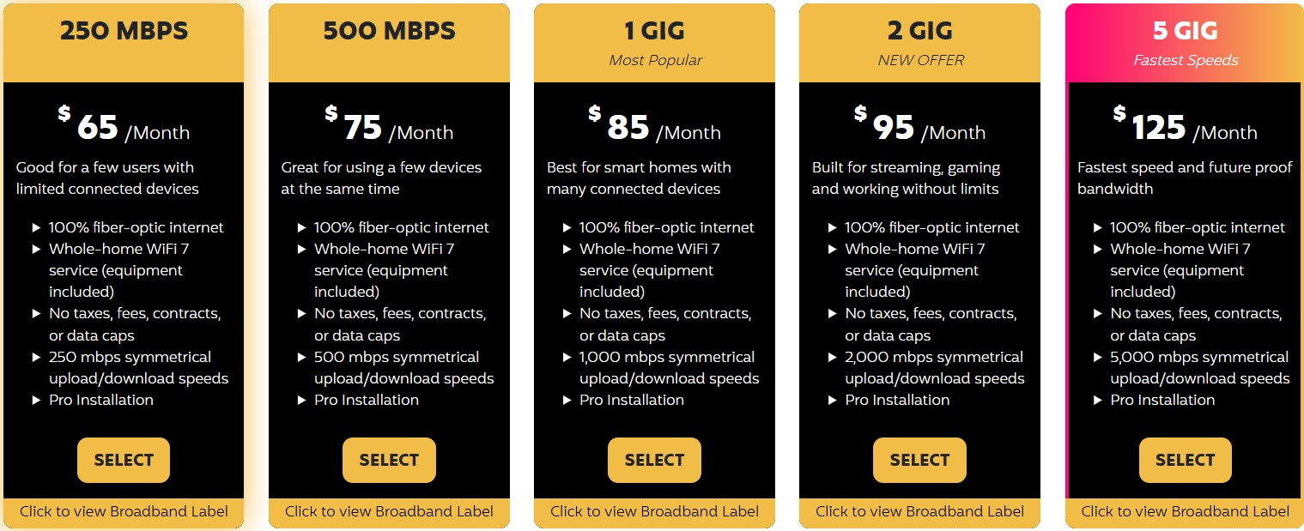
IQ Fiber Residential Packages

Slide 12


Slide 13
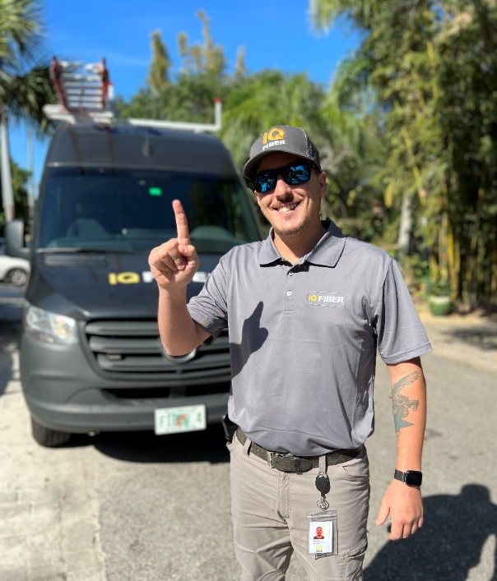
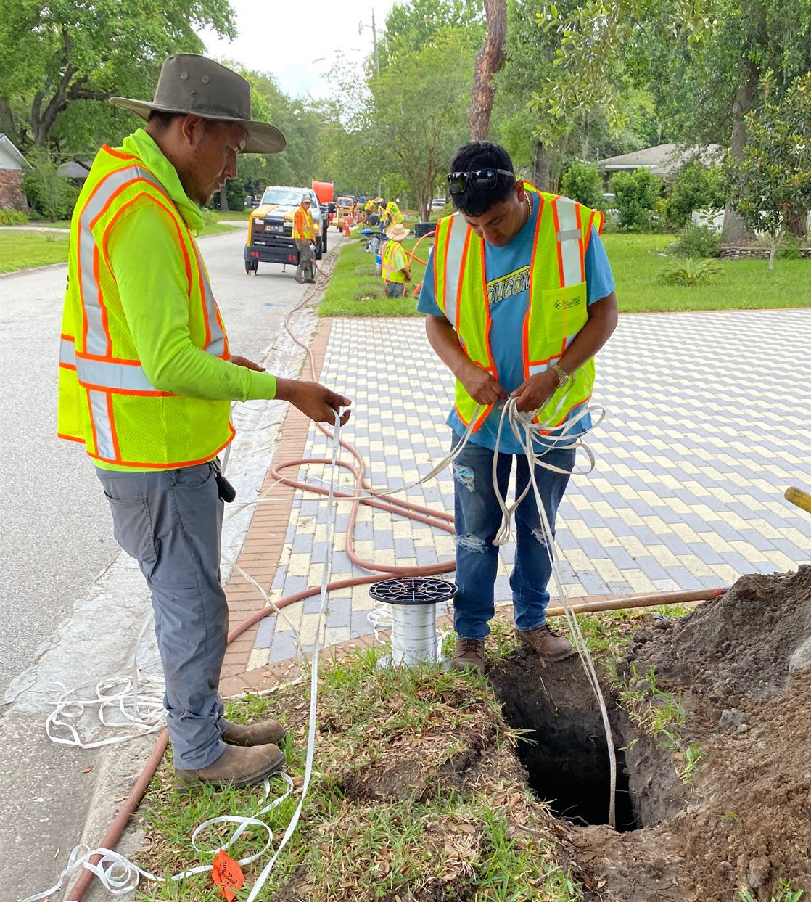


Delaware has a new fiber-optic internet solution.
Strong executive team with deep telecom experience and proven ability to deliver a superb customer experience.
Backed by a powerful financial partner:
Building a Delaware based team to run operations locally.
We will partner with you for key sponsorships and community engagement
One of the highest customer satisfaction scores in the industry

Slide 14
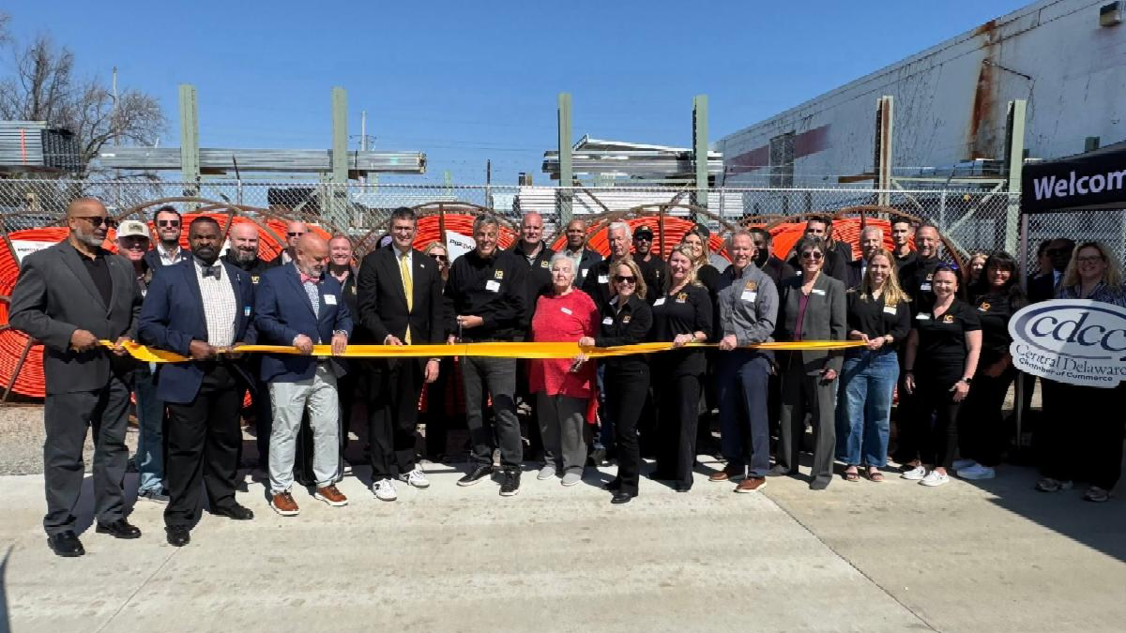
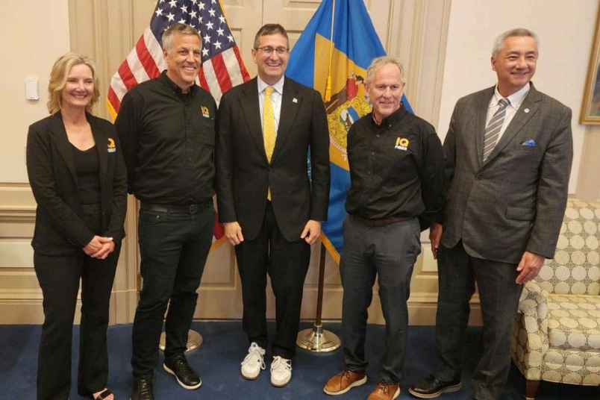
We’re making headlines
Governor Matt Meyer on IQ Fiber
We just marked a major step forward for connectivity in Delaware with IQ Fiber’s investment to expand high-speed broadband across our state.
Their fiber-to-the-home network will deliver faster, more reliable internet to thousands of Delawareans, especially in rural communities, while creating jobs and strengthening our economy.
IQ Fiber has been chosen as the first company to go through Delaware's new permitting accelerator for it’s plans to bring broadband Internet across 4,000 miles in southern Delaware.

